Slide 1

Virtual Currency Exchange Platform (VCEP) A Web-based Virtual Currency Exchange for IST303 Course
Group 4 Members: Ahmed, Ameya, Clement, Divya

Slide 2
Outline
Introduction
Application Features Overview
User Stories
Milestone 1.0 Overview
Agile Development Methodology (Scrum)
Sprint Planning and Meetings
Tasks Tracking
Scrum Roles and Responsibilities
Project Demo and code explanation
Milestone 2.0 Overview

Slide 3

Introduction
The objective of the project is to create a web-based platform for simulating the experience of trading virtual currencies, including functionalities like currency conversion, tracking currency values, and managing virtual portfolios.

Slide 4
Application Features Overview
User Registration and Authentication
User
Dashboard
Real-time Currency Data
Transaction History
User Portfolio Management
Currency Conversion and Trading

Slide 5

User Stories
As a user, I want to be able to register an account using my email and password.
As a user, I want to be able to log in to my account using my email and password to access my dashboard.
As a logged-in user, I want to access a dashboard that shows an overview of my account.
As a user, I want to view real-time currency exchange rates to make informed trading decisions.
As a user, I want to be able to buy virtual currencies at the current market rate.

Slide 6
User Stories
6. As a user, I want to be able to sell virtual currencies at the current market rate.
7. As a user, I want to view my transaction history to track my past activities.
8. As a user, I want to see the current value of my portfolio, so that I know the performance of my investments.
9. As a user, I want to be able to communicate with other users.

Slide 7

Milestone 1.0
Total: 23 days (until 03/06/2024 when Milestone 1 is due)
Iteration 1: User Account Management and Dashboard
Duration: 11 days.
Iteration 2: Real-time Data and Basic Trading Functionality
Duration: 12 days.

Slide 8
Iteration 1: User Account Management and Dashboard
Duration: 11 workdays
On (60% velocity) Days of actual work: 4 (Four Team Members) * 11 * 0.60 = 26 Days
1. User Registration:
9 days
2. Database Setup:
7 days
3. Login System:
6 days
4. Basic Dashboard:
4 days

Slide 9
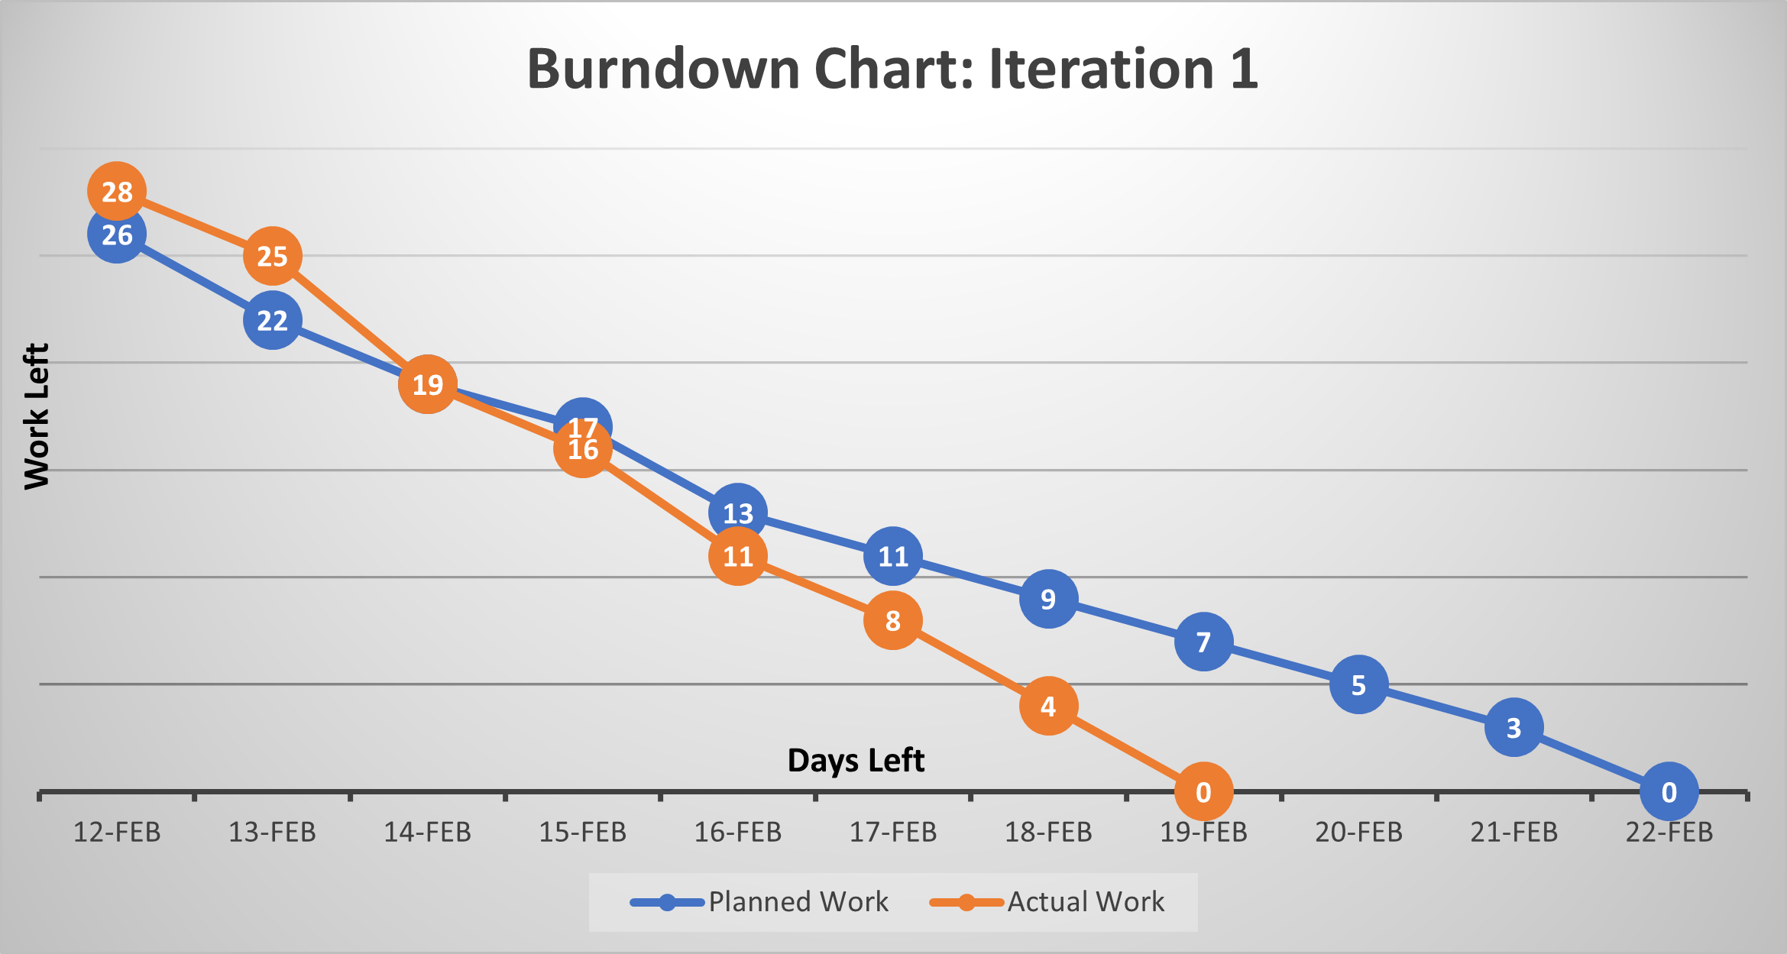
Burndown Chart iteration1

Slide 10
Iteration 2: Real-time Data and Basic Trading Functionality
Duration: 12 workdays
On (60% velocity) Days of actual work: 4 (Four Team Members) * 12 * 0.60 = 29 Days
1. UI for trading functions:
4 days
2. Real-time Currency Exchange Rates Viewing:
8 days
3. Cryptocurrency Chatroom Trading:
9 days
User communication and chatting:
8 days

Slide 11
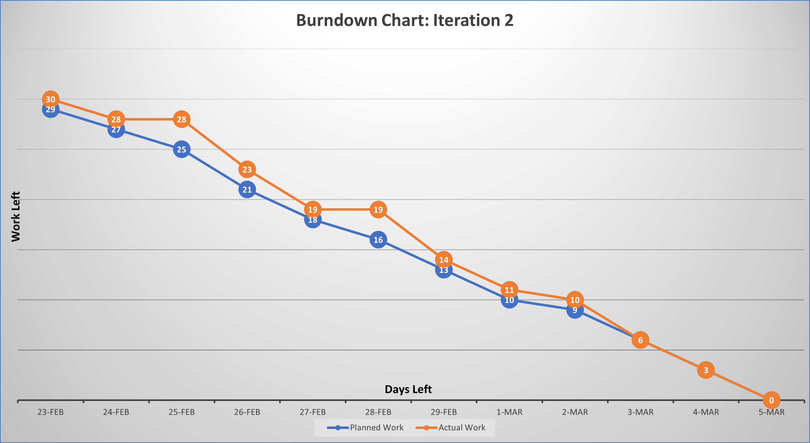
Burndown Chart iteration2

Slide 12

Agile Development Methodology (Scrum)
The project requires incremental and iterative development
The project needs continuous feedback
Our project requirements might evolve and change.
The project is for educational purposes not commercial, so it allows for flexibility in responding to changes.
Scrum emphasizes teamwork, active learning, accountability, and iterative progress.
No customers are directly involved in the project cycle.

Slide 13
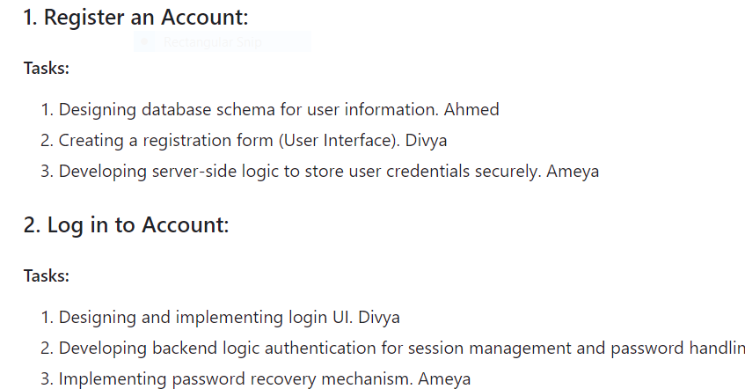

Sprint Planning and Meetings:
To make sure Scrum framework is followed:
Firstly, the team creates a sprint goal and allocates tasks within team capacity.
The team tracks tasks using different tools.
The team meets twice weekly to track tasks and sprint backlog.

Slide 14
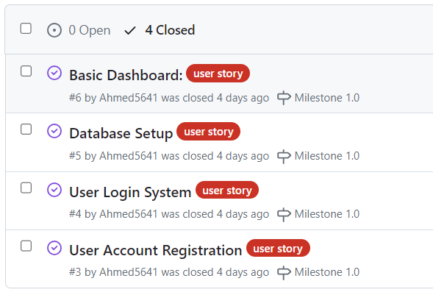
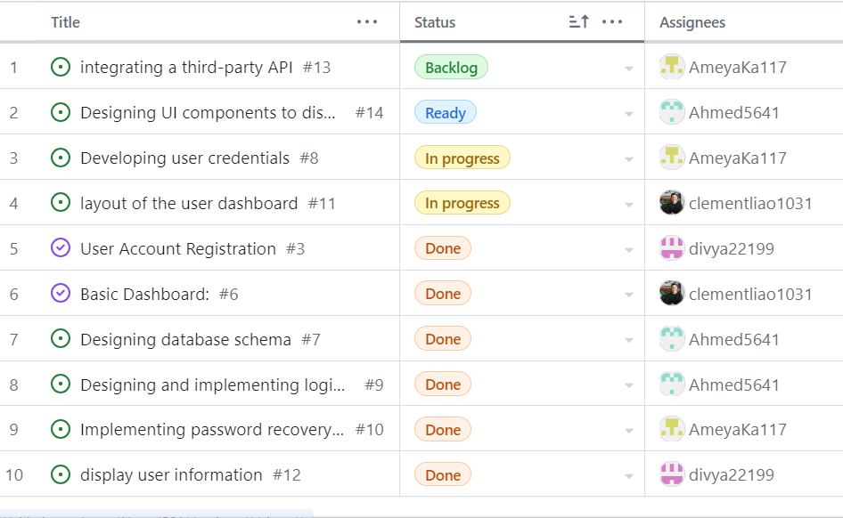
Tasks Tracking

Slide 15
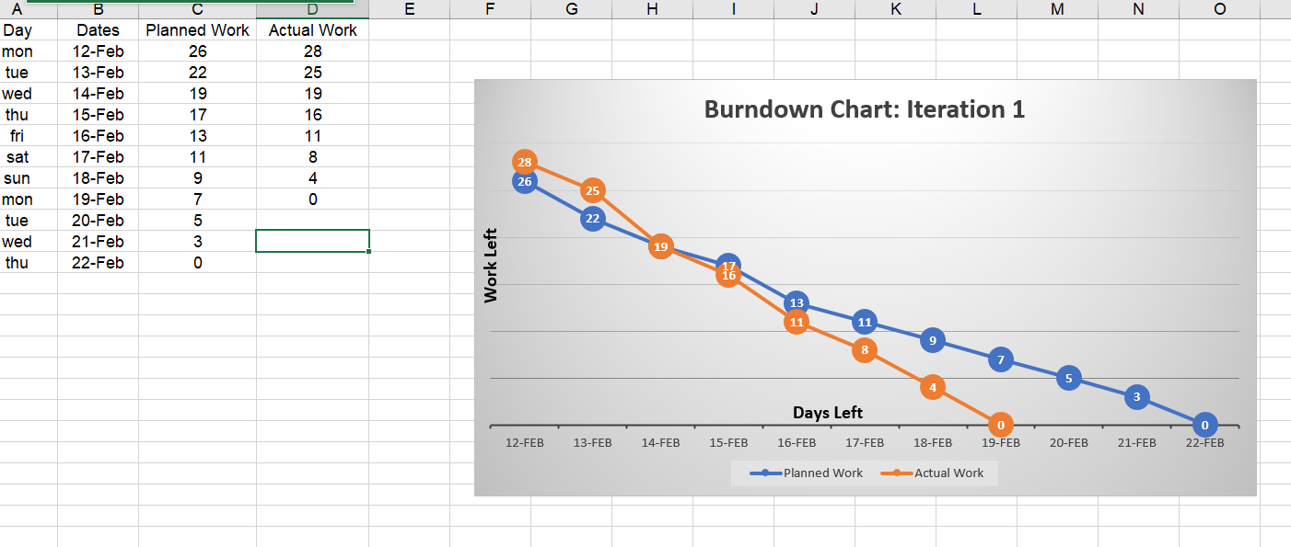
Tasks Tracking
We used burn-down charts to visually document sprint progress and facilitate discussions during Scrum events.

Slide 16
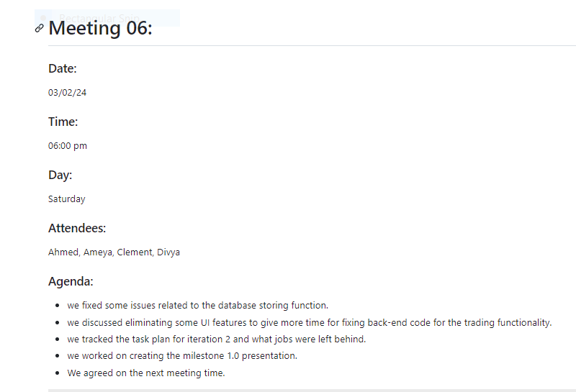
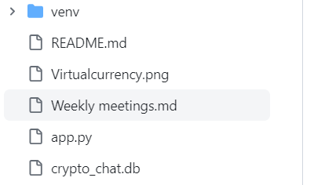
There is a folder in the project repo for all meeting records.

Slide 17
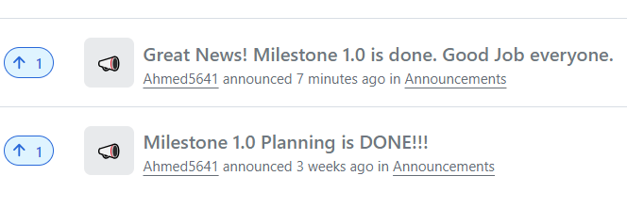
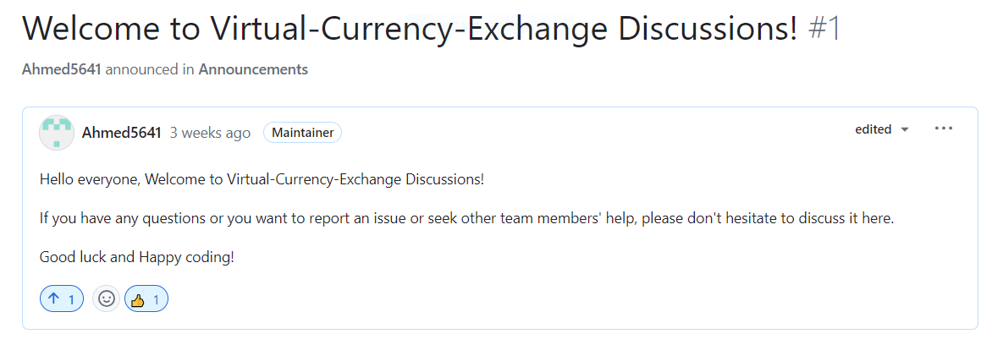
We used GitHub discussions and project announcements for team encouragement.

Slide 18
Roles and Responsibilities:
Scrum Master: Ahmed
Product Owner: Ameya
Development Team: Divya, Clement, Ameya, Ahmed

Slide 19

Project Demo

Slide 20

Milestone 2.0
Transaction History: Track and display the history of user transactions.
User Portfolio Management: Allow users to view their current virtual currency holdings.
User communication forum: Allow users to communicate with each other.

Slide 21
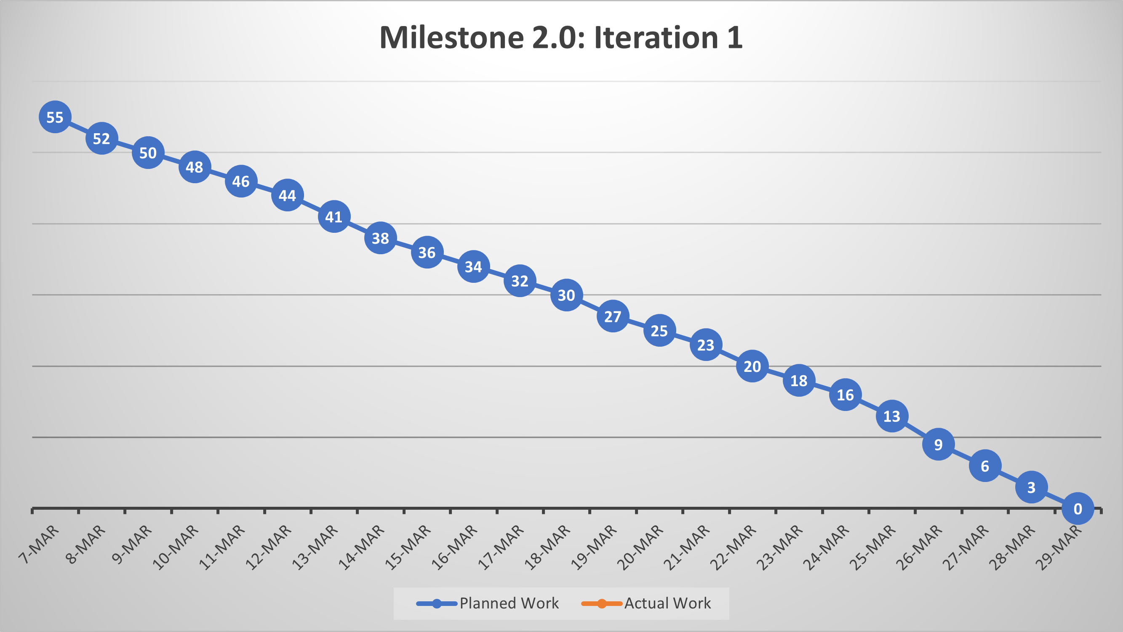
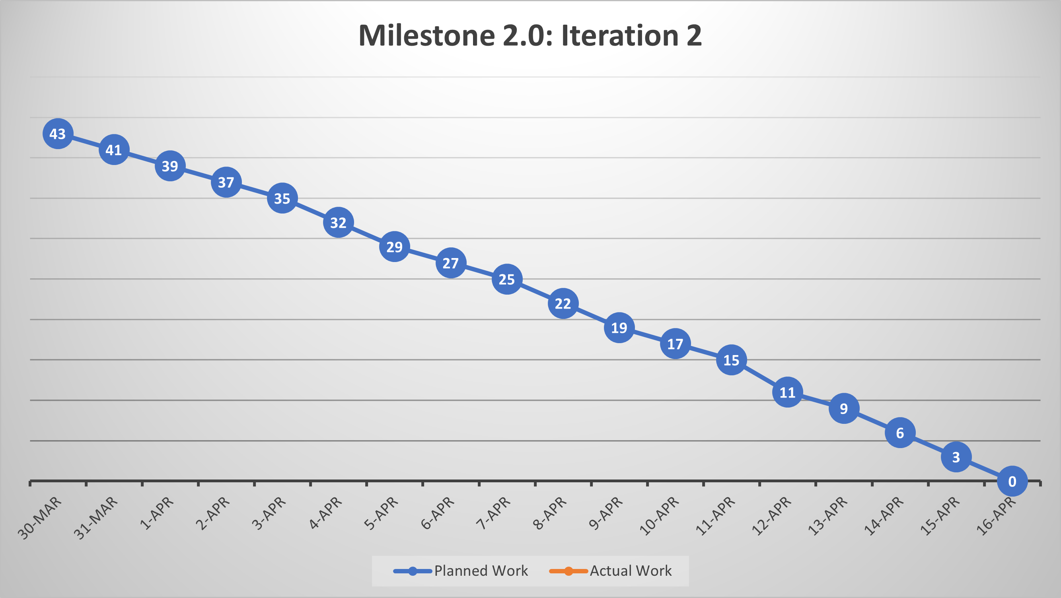
Milestone 2.0
Total: 41 days (until 04/17/2024 when Milestone 2.0 is due)
Iteration 1: Transaction History and Portfolio Management: 23 days.
23 working days (at 60% velocity):
4 (Four Team Members) * 23 * 0.60 = 55 Days
Iteration 2: User communication and forum: 18 days.
18 working days (at 60% velocity):
4 (Four Team Members) * 18 * 0.60 = 43 Days

Slide 22
Presentation End
Thank you

